Slide 1
Evaluation Metrics in Classification

Slide 2
Introduction
Evaluation metrics explain the performance of a model.
Imagine that we have an historical dataset which shows the customer churn for a telecommunication company.
We have trained the model, and now we want to calculate its accuracy using the test set.
We pass the test set to our model, and we find the predicted labels.
Now the question is, “How accurate is this model?”
Basically, we compare the actual values in the test set with the values predicted by the model, to calculate the accuracy of the model.

Slide 3
Evaluation metrics provide a key role in the development of a model, as they provide insight to areas that might require improvement.
There are different model evaluation metrics but we will talk about three popular metrics:
Jaccard index
F1-score and
Log Loss.

Slide 4
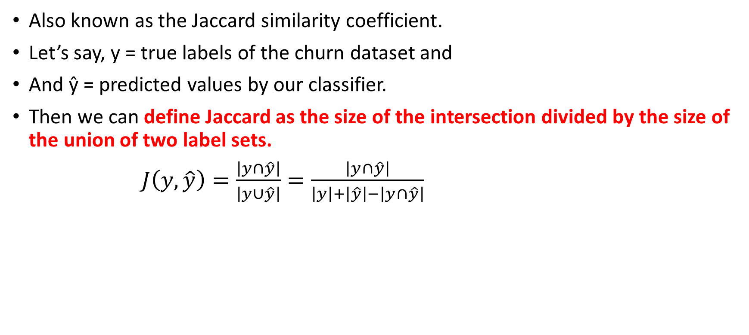
Jaccard index

Slide 5
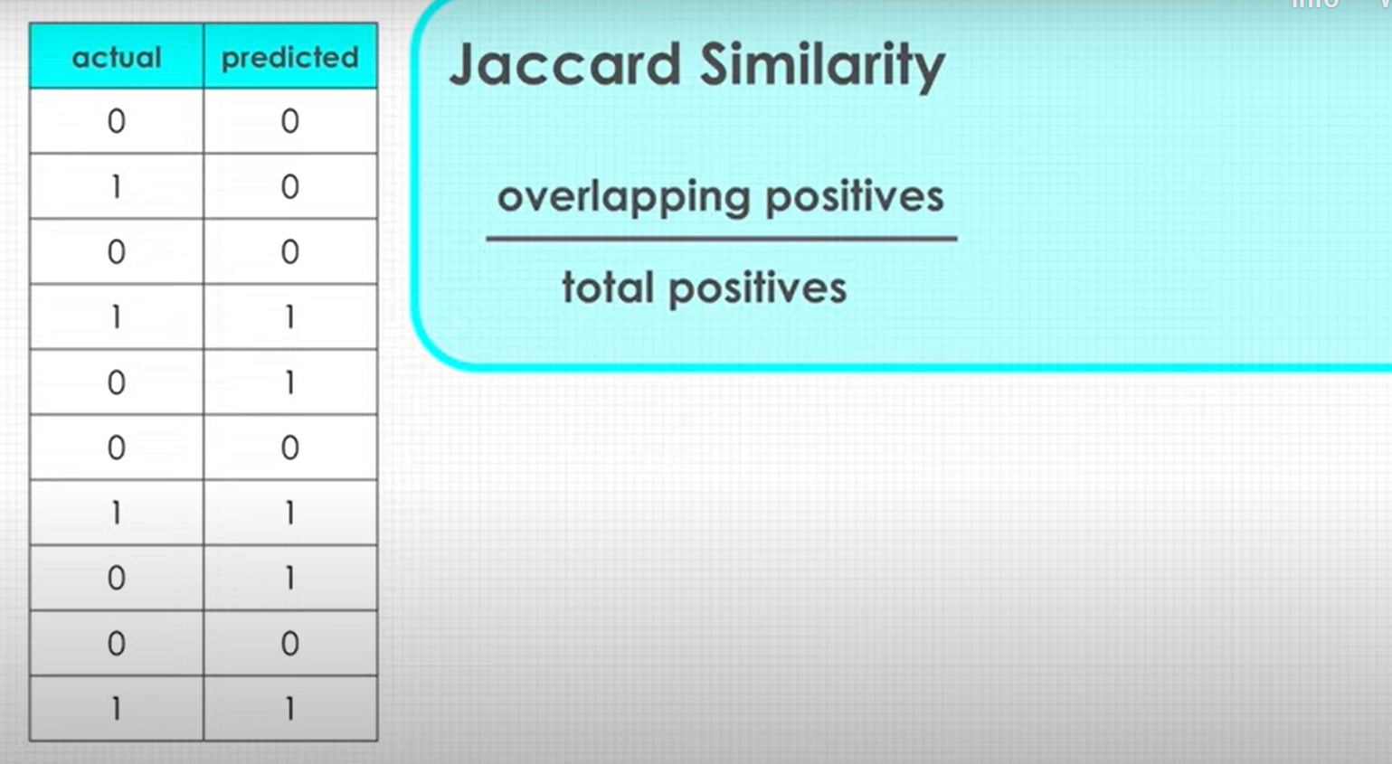
Jaccard index

Slide 6
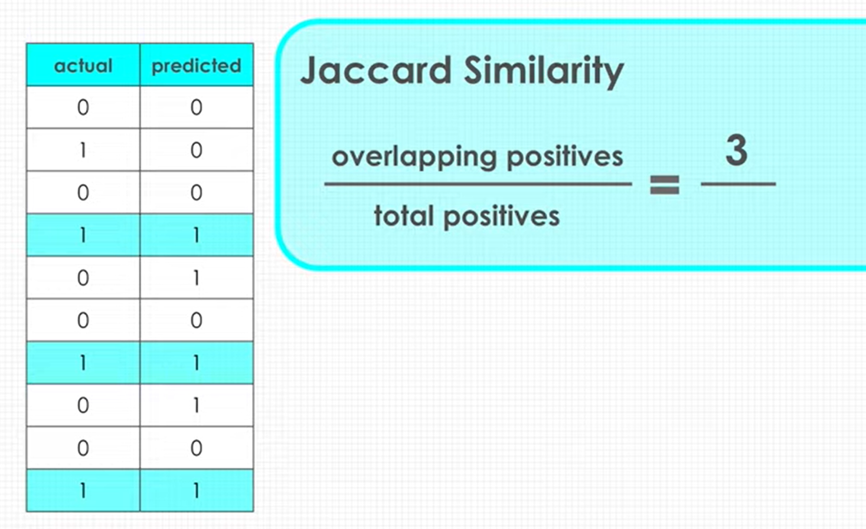
Jaccard index

Slide 7
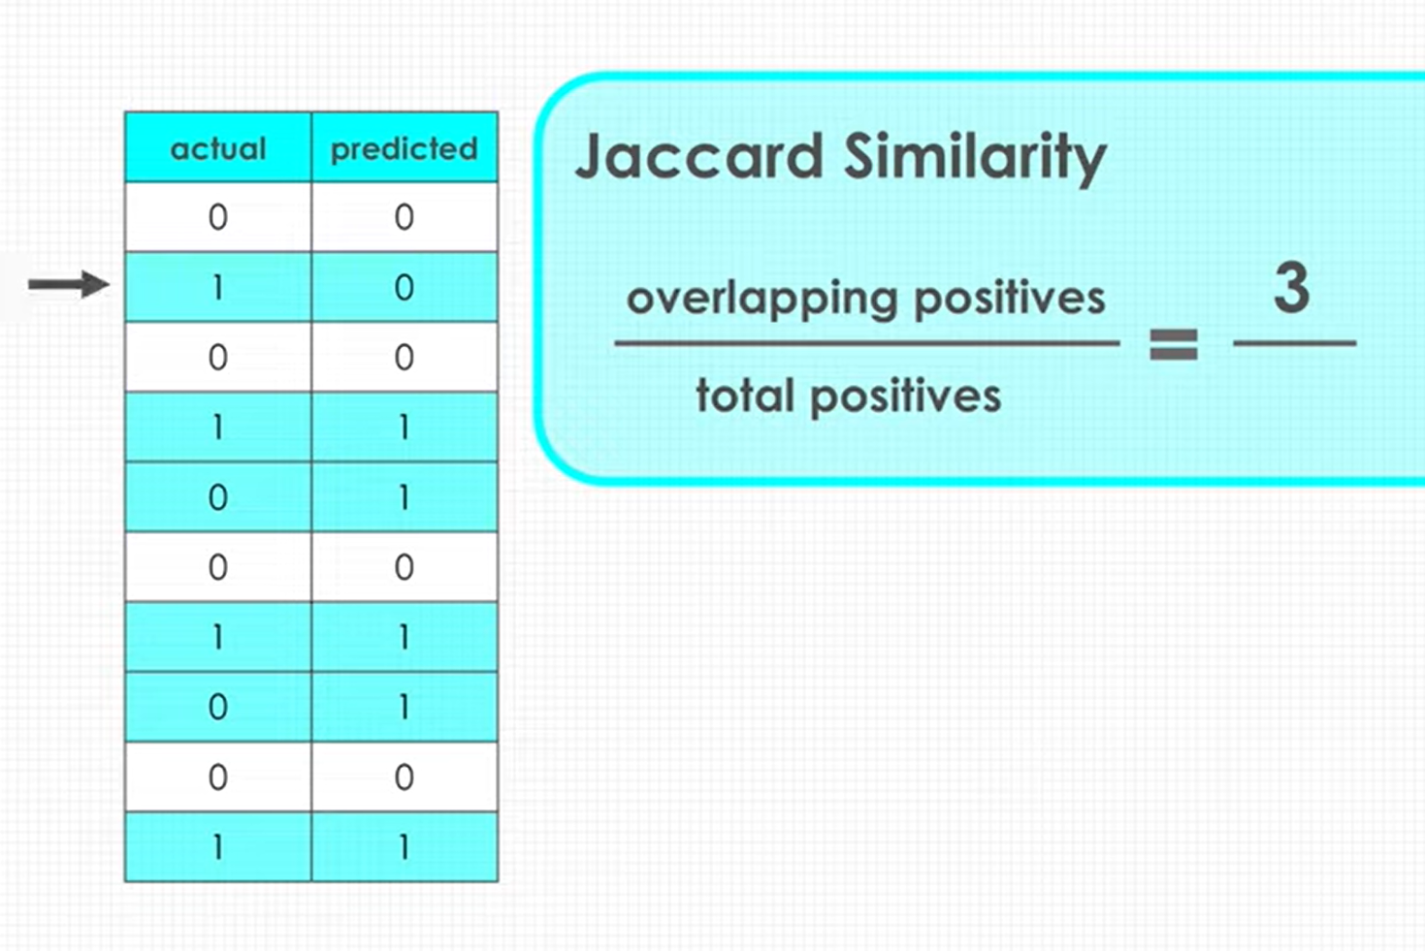
Jaccard index

Slide 8
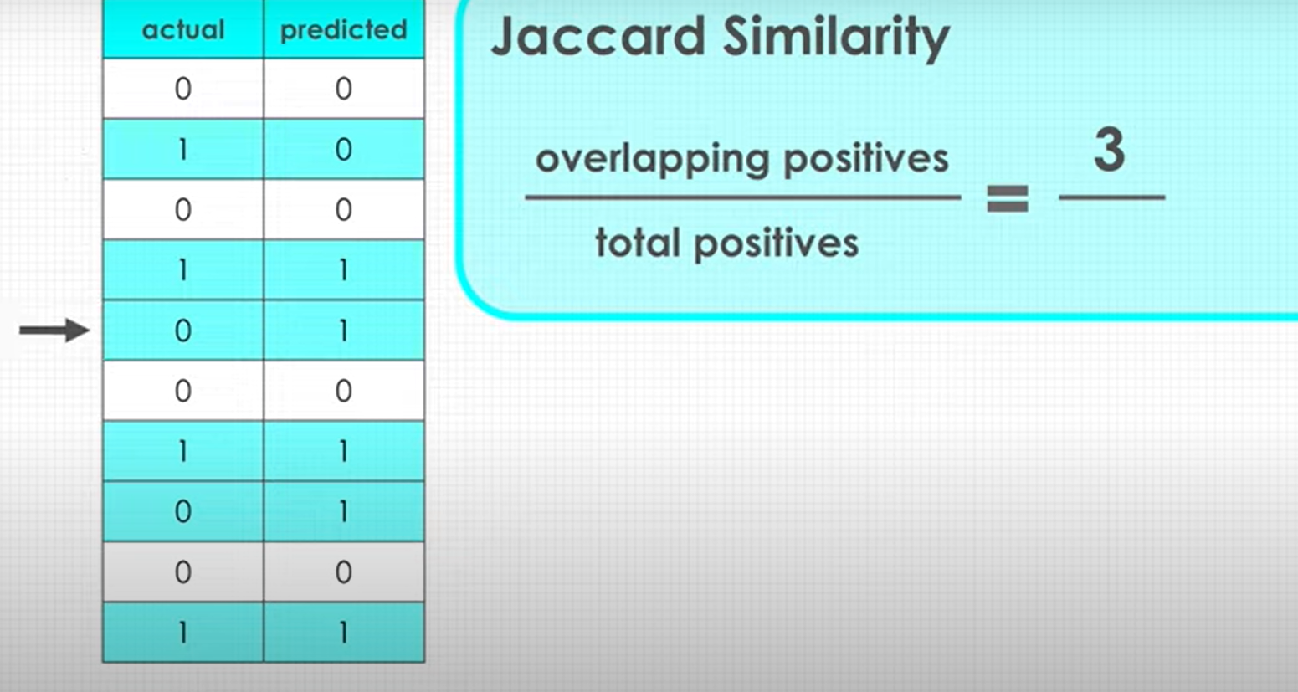
Jaccard index

Slide 9
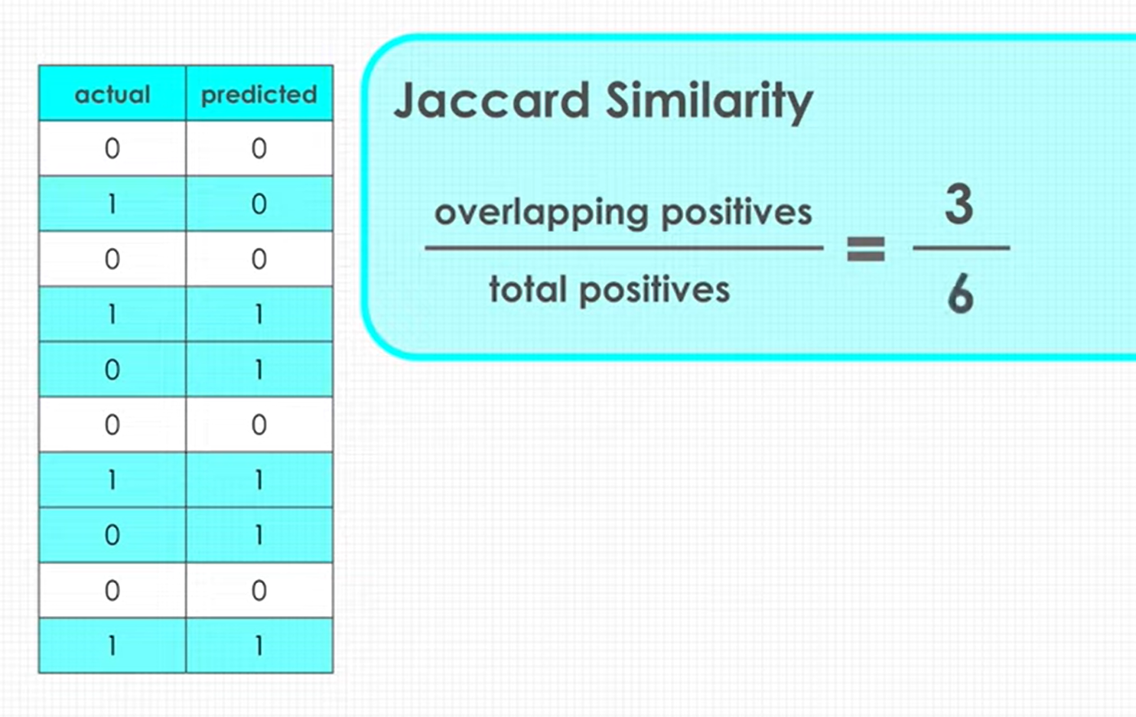
Jaccard index

Slide 10
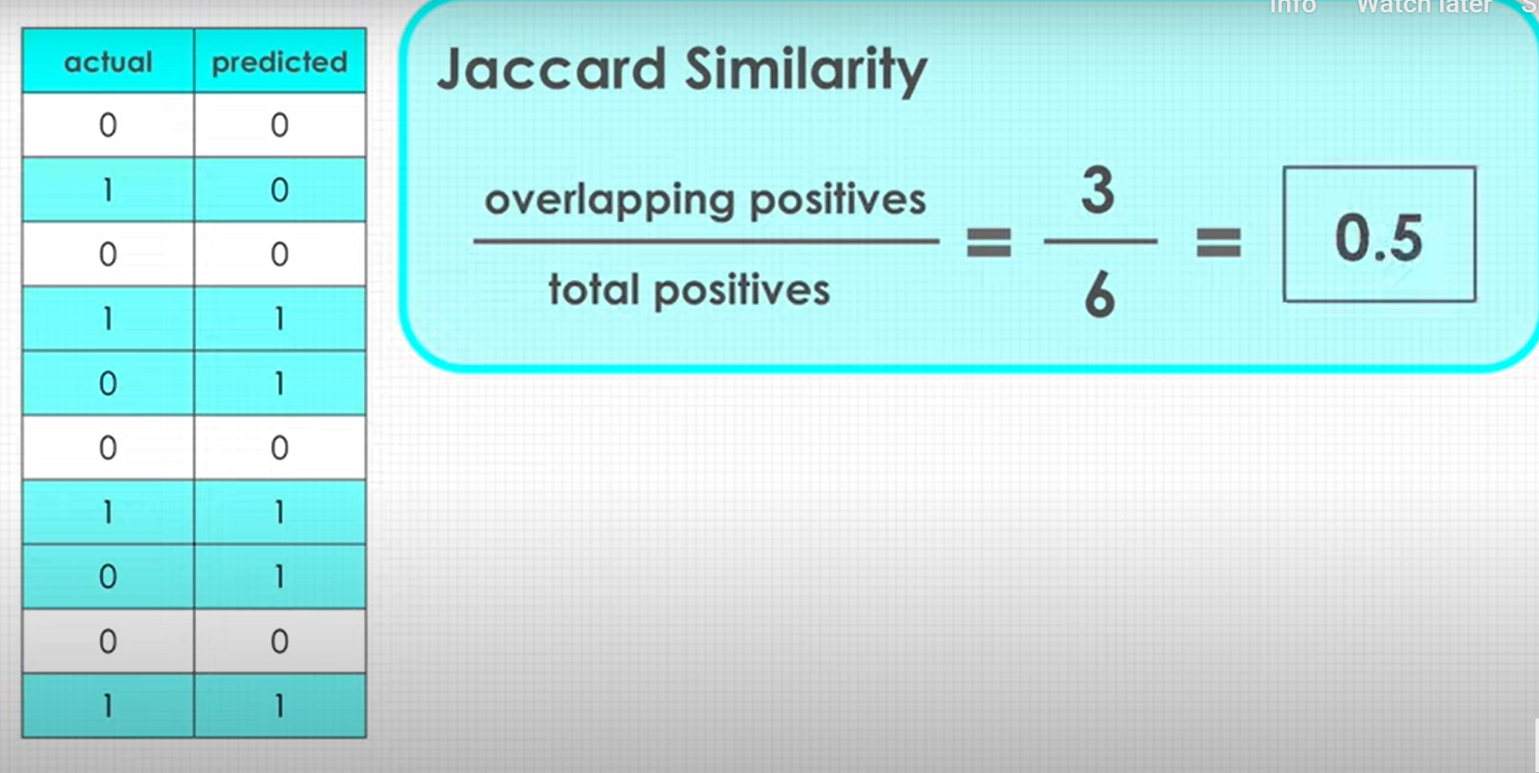
Jaccard index

Slide 11
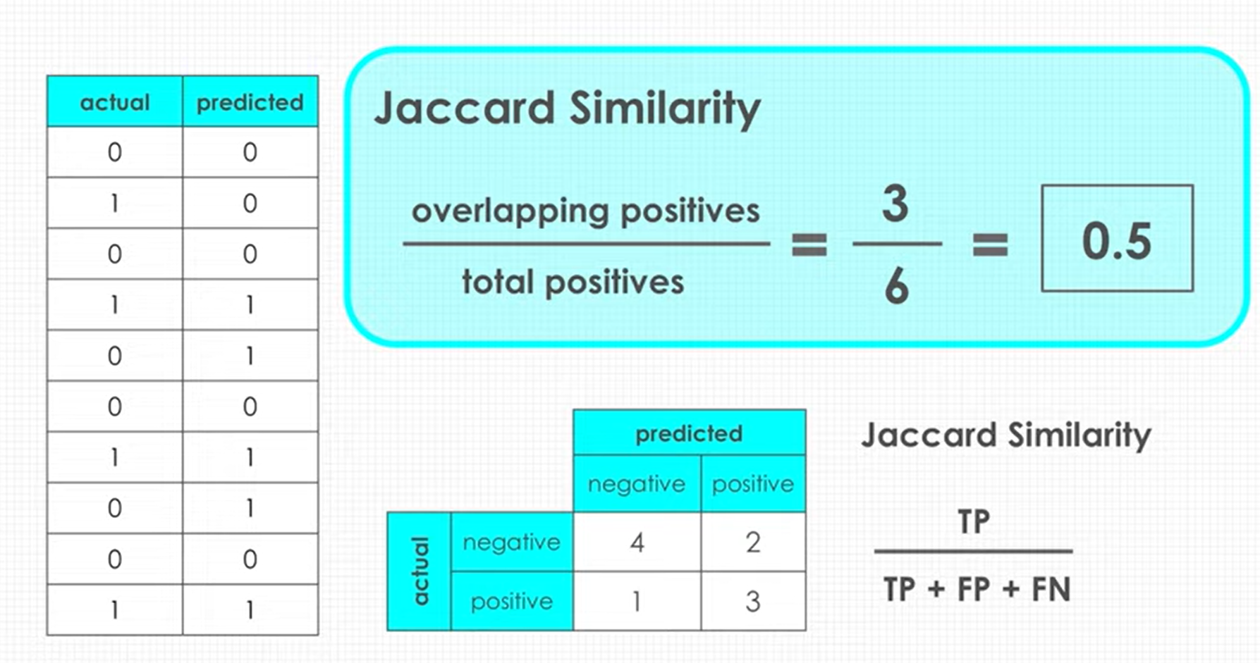
Jaccard index

Slide 12
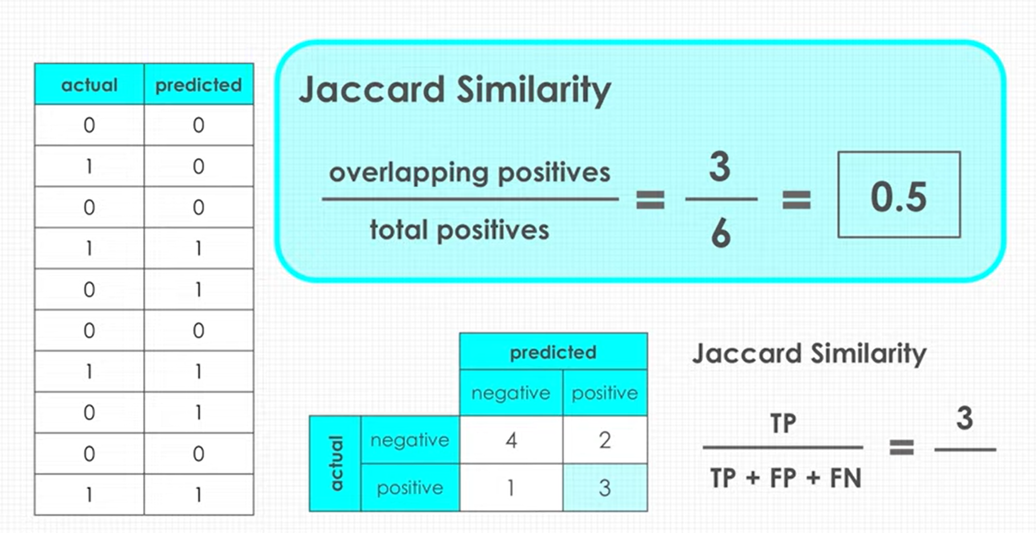
Jaccard index

Slide 13
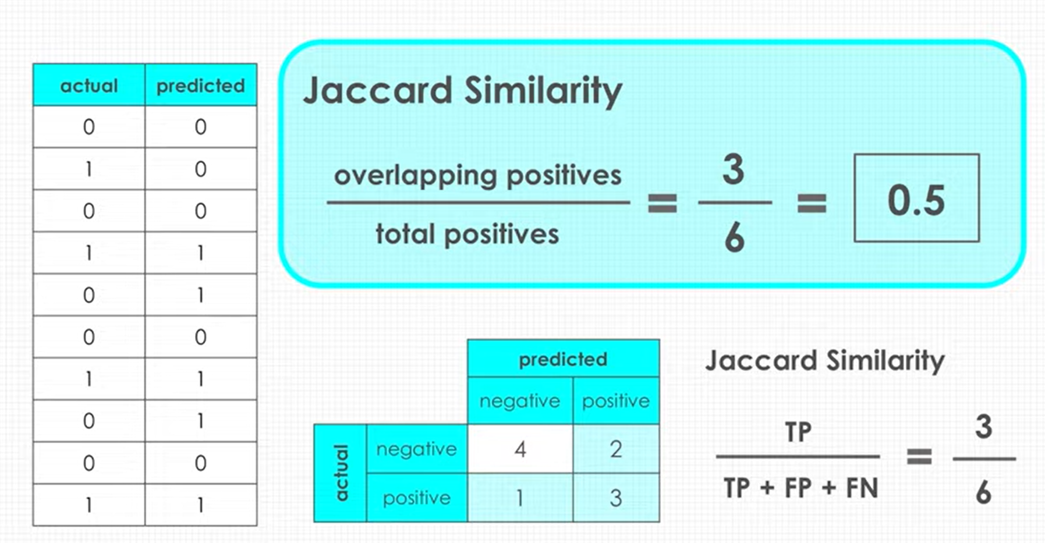
Jaccard index

Slide 14
If the entire set of predicted labels for a sample strictly matches with the true set of labels, then the subset accuracy is 1.0; otherwise it is 0.0.
Another way of looking at accuracy of classifiers is to look at a confusion matrix.

Slide 15
Confusion Matrix
The confusion matrix is another metric that is often used to measure the performance of a classification algorithm.
Let’s focus on binary classifiers as with the spam filtering example, in which each email can be either spam or not spam.
The confusion matrix will be of the following form:
P R E D I C T E D V A L U E S
 | Real Email | Spam Email
Real Email | TN | FP
Spam Email | FN | TP
A C T U A L V A L U E S

Slide 16
The predicted classes are represented in the columns of the matrix, whereas the actual classes are in the rows of the matrix.
We then have four cases:
True positives (TP): the cases for which the classifier predicted ‘spam’ and the emails were actually spam.
True negatives (TN): the cases for which the classifier predicted ‘not spam’ and the emails were actually real.
False positives (FP): the cases for which the classifier predicted ‘spam’ but the emails were actually real.
False negatives (FN): the cases for which the classifier predicted ‘not spam’ but the emails were actually spam.

Slide 17
The entries of the confusion matrix are the number of occurrences of each class for the dataset being analysed.
Let’s obtain the confusion matrix for our spam filtering algorithm, by using the function confusion_matrix:
from sklearn.metrics import confusion_matrix
print(confusion_matrix(y_test, y_pred))
The output is:
[[724 7]
[ 1 136]]

Slide 18
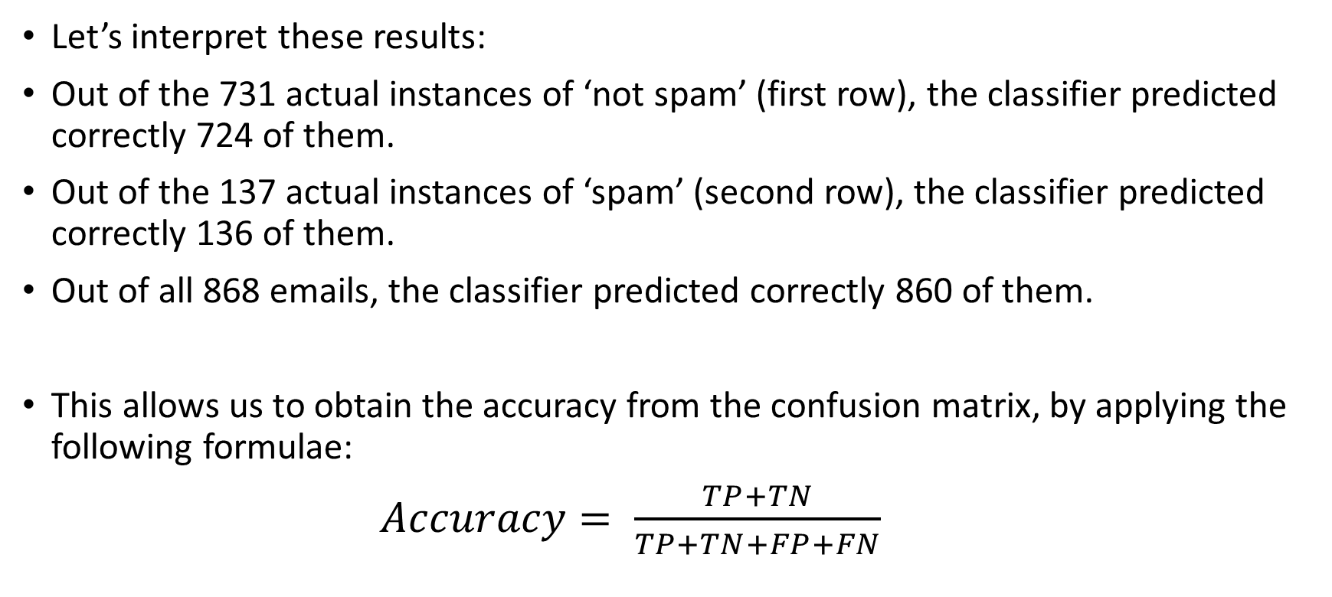

Slide 19
We obtain again that 99% of the predicted outputs were correctly classified.
However, the confusion matrix allows us to have a better picture of the performance of the algorithm.

Slide 20
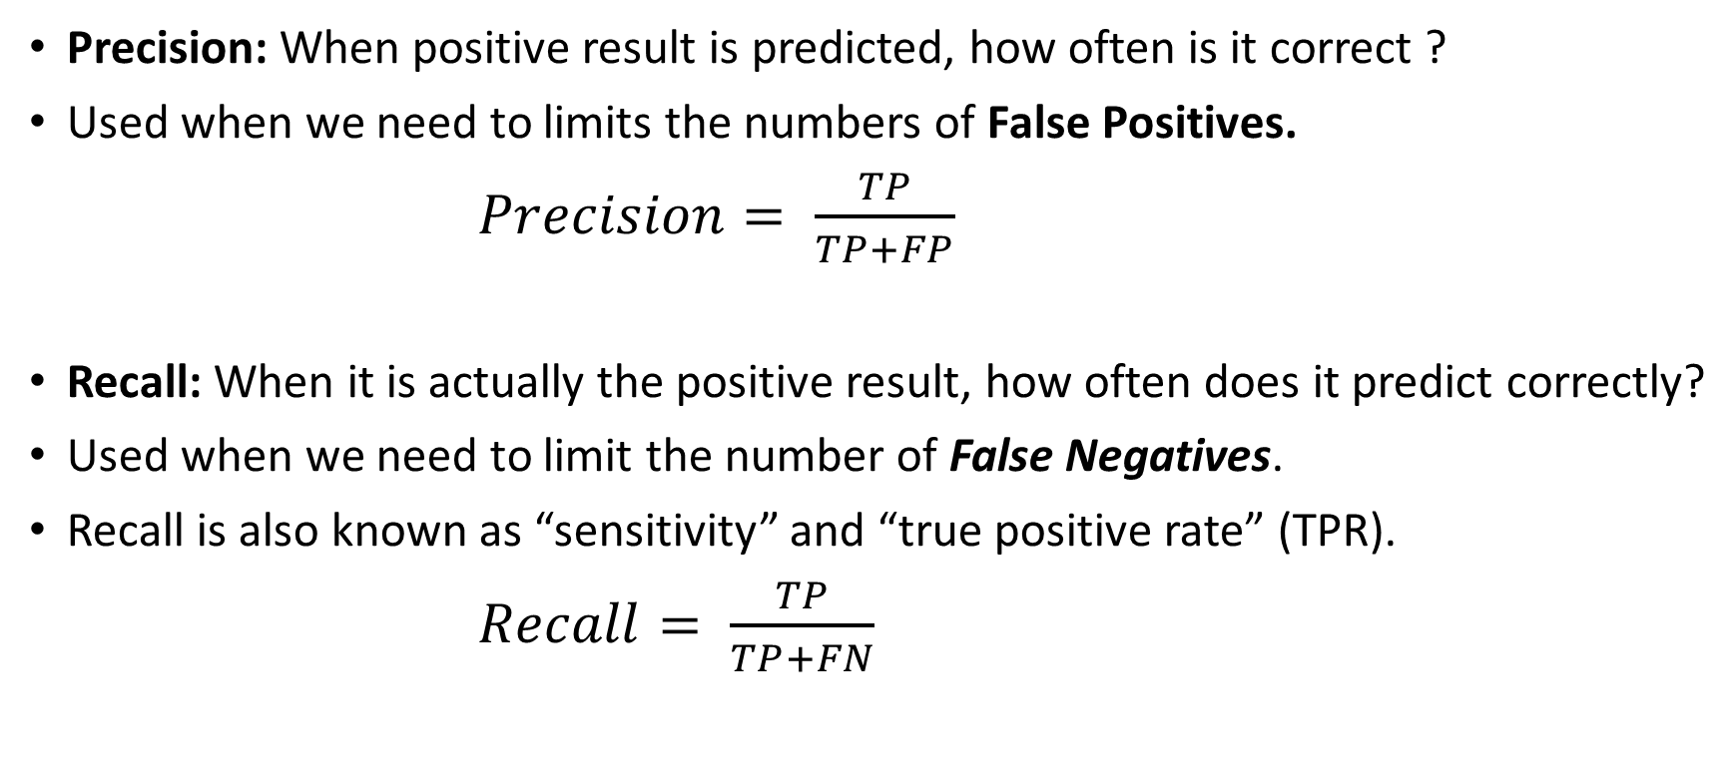
Precision, recall and f1-score

Slide 21
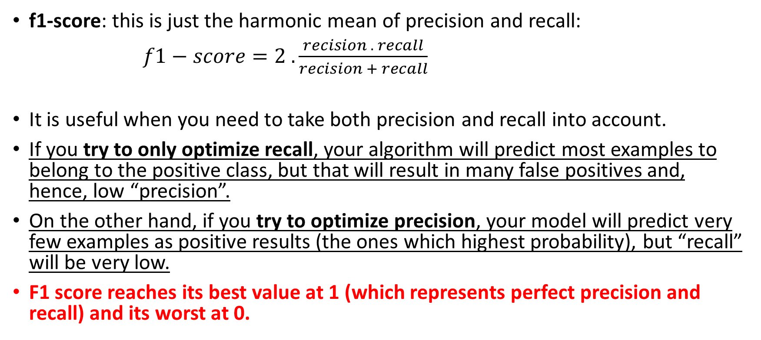
Precision, recall and f1-score

Slide 22
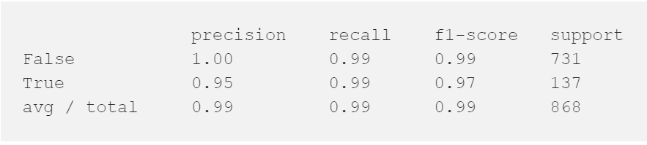
Simulation Output
from sklearn.metrics import classification_report
print(classification_report(y_test, y_pred))
The output is:

Slide 23
Logarithmic (Log) Loss
Now let's look at another accuracy metric for classifiers.
Sometimes, the output of a classifier is the “probability of a class label”, instead of the “label”.
For example, in logistic regression, the output can be the probability of customer churn, i.e., yes (or equals to 1).
This probability is a value between 0 and 1.
Logarithmic loss (also known as Log loss) measures the performance of a classifier where the predicted output is a probability value between 0 and 1.

Slide 24
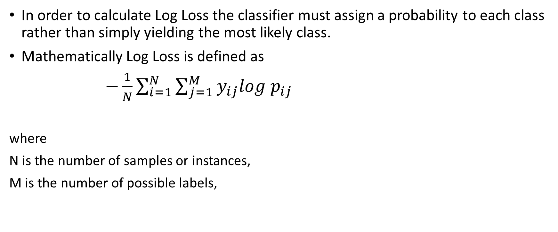
Log Loss

Slide 25

Please contact
Foundation for Innovation and Collaborative
Education
mentor@fice.in
www.fice.in
Please contact
Foundation for Innovation and Collaborative
Education
info@fice.in
mentor@fice.in
Notes:
Here are the lessons we are going to learn today.

